Slide 1
Group 37
Progress Report
Alex Bailey
Ben Wick
Dylan Washburne

Slide 2
Background
Current Methods of Tracking Object Velocity
Radar Gun
LIDAR Gun
Shortcomings
Weather problems
Only one target
Need to Aim
Needs an active operator

Slide 3
Project Overview
Allow a stationary camera to track nearby objects that pass by
Return the tracked objects’ velocities to the user
Velocities 90% accurate
Notes:
Our project's purpose is to make it so that a stationary camera can detect nearby objects and report their current velocities to the user. This is to return velocities with a minimum accuracy of 90% of their actual velocities. This must also work at long enough ranges that is competes with current methods of velocity tracking, such as radar guns. The purpose for this is to act as an alternative to the current methods of velocity tracking.

Slide 4
Purpose
Act as alternative method of velocity tracking
If we choose:
Cars
Speed limit enforcement
Vehicle data gathering
People
Sports analysis
Group velocity pattern

Slide 5
Requirements
70% of the time a desired object is in frame, it will be detected
Should be able to track objects up to 100m away with our stated 70% reliability
Must be capable of tracking multiple objects simultaneously
Camera feed is stored for later viewing
Object velocities are stored for data analysis

Slide 6
Design
We will have two adjacent cameras facing in the same direction recording the video feed
The cameras will ideally be stereoscopic
The computer will process the images, using a library such as OpenCV to identify relevant objects in the scene

Slide 7
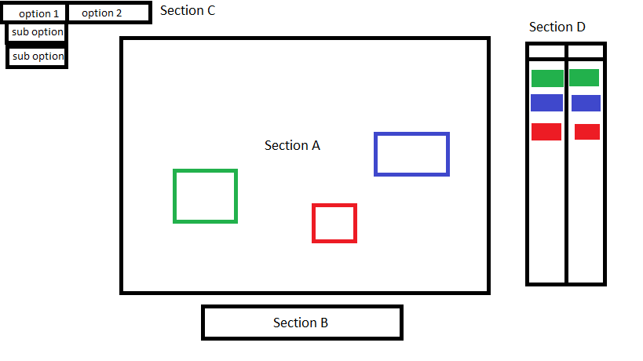
User Interface

Slide 8
Issues and Challenges
Unfamiliar with LaTeX at first
Unfamiliar with document types
Selecting a camera system

Slide 9
Current Project Status
All preliminary documents complete
Necessary resources researched

Slide 10
What’s next?
Select camera
Implement object recognition
Develop user interface

